Slide 1
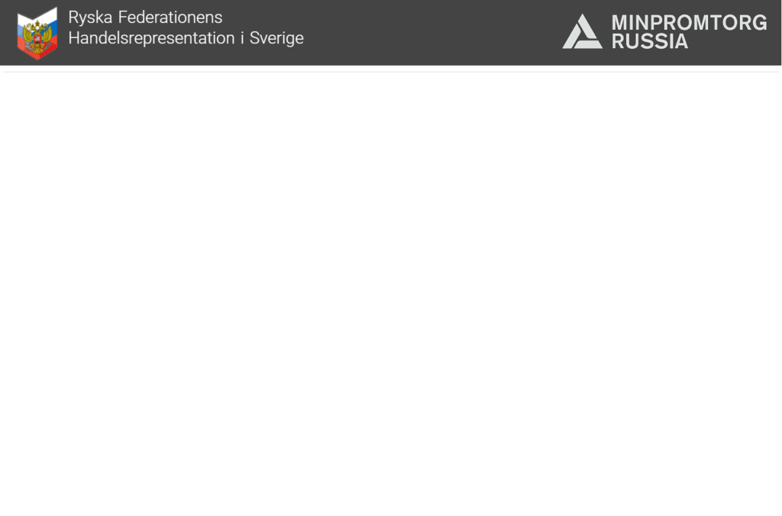

Trade Representation
of the Russian Federation
in the Kingdom of Sweden
under the
Ministry of Industry and Trade
of the Russian Federation

Slide 2
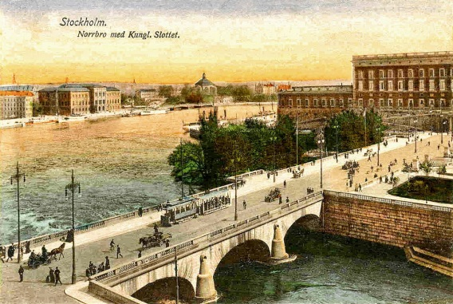
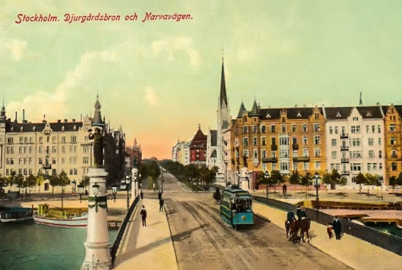
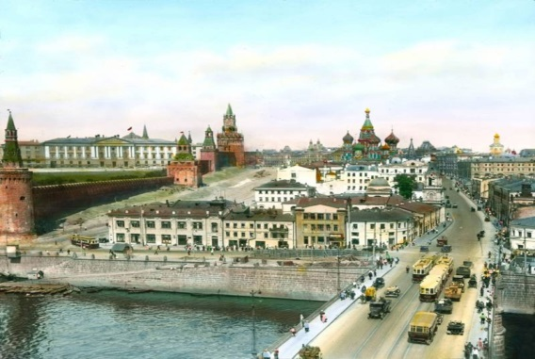
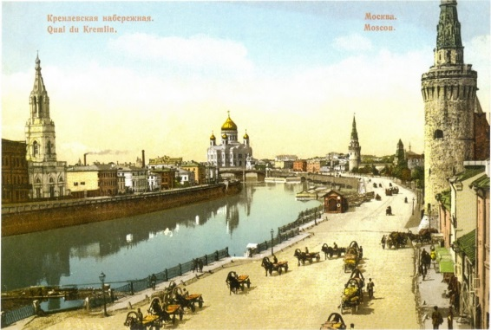

Brief History of Mutual Trade and Economic Relations (1910s-1930s)
On May 27, 1918 Plenipotentiary representative of the RSFSR V. Vorovsky signed a contract with the Swedish company Jensen & Co. for the sale of thousands of tons of hemp. Sweden was the first western country that resumed trade with Russia, and the share of imports from Sweden in 1920 amounted to 26% of the total imports.
In October 1927, the Convention between the USSR and Sweden «On the Legal Status of the Trade Representation of the USSR in Sweden» was signed. This Soviet-Swedish foreign trade legal basis gave impetus to the development of mutual trade.
Trade Representation of the Russian Federation in the Kingdom of Sweden
Ministry of Industry and Trade of the Russian Federation

Slide 3
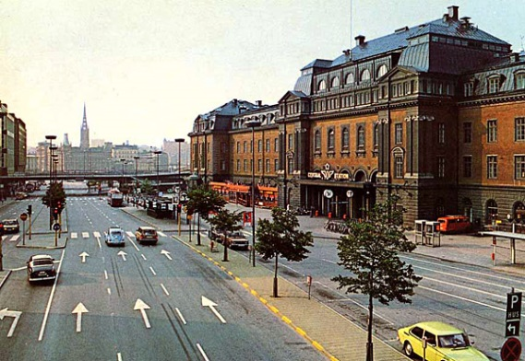
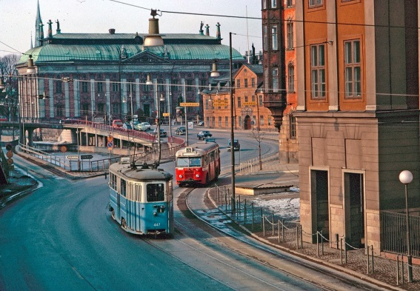
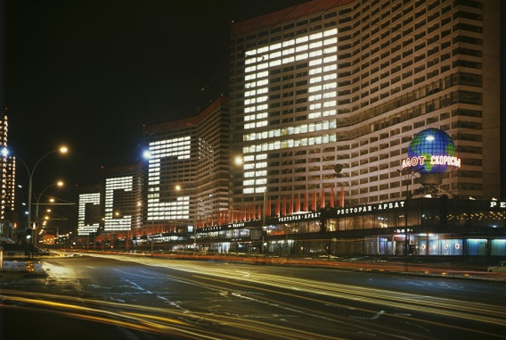
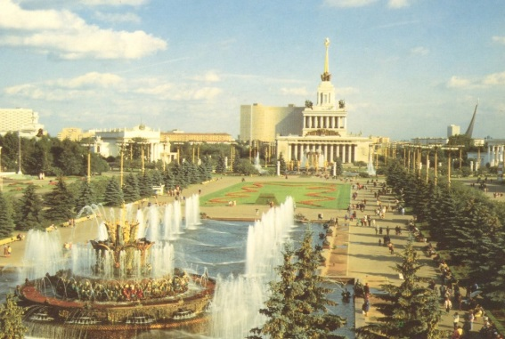
Brief History of Mutual Trade and Economic Relations (1940s-1980s)
During the Second World War, an agreement on trade and payments between the USSR and Sweden was signed, as well as an agreement on granting the USSR a loan to pay for Soviet orders placed in Sweden. The Trade representation obtained the right to issue bills for payment of goods supplied during the war from Sweden to the USSR.
The 1970s marked a new Long-Term Trade Agreement for the period 1971-1975 which was signed between the USSR and Sweden. This fundamental document reflected the desire of the parties to develop bilateral trade.
Trade Representation of the Russian Federation in the Kingdom of Sweden
Ministry of Industry and Trade of the Russian Federation

Slide 4
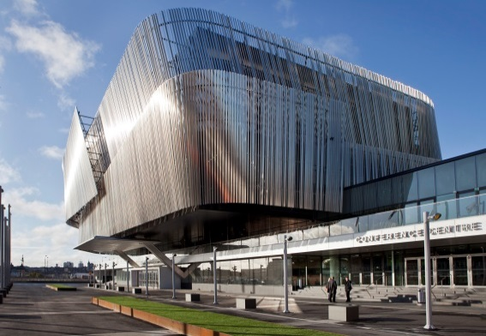
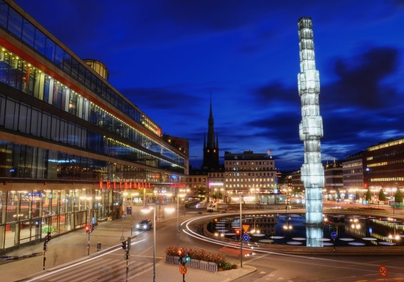
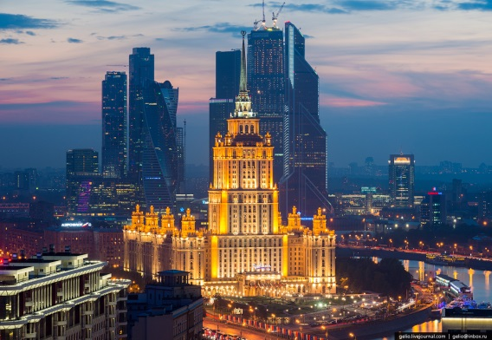
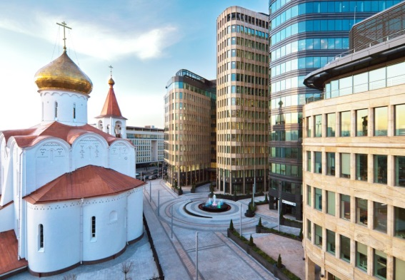
Brief History of Mutual Trade and Economic Relations (1990s-2010s)
The stagnation of the 1990s was replaced by a rise in bilateral trade, which we had observed before the European sanctions were imposed. During this period such well-known Swedish companies as IKEA, H&M, Volvo, Scania, ABB, Alfa Laval, Ericsson, Oriflame, SCA, AstraZeneca entered the Russian market and many of them launched in Russia.
After the introduction of sanctions against Russia in 2014, mutual trade and investments have been declining, but the business circles of both continue to show cautious interest in joint projects. More than 600 Swedish companies are currently operating in Russia.
Trade Representation of the Russian Federation in the Kingdom of Sweden
Ministry of Industry and Trade of the Russian Federation

Slide 5
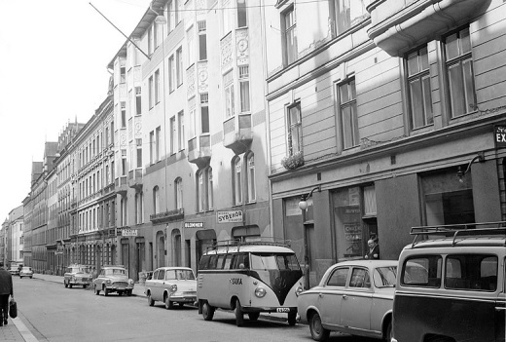
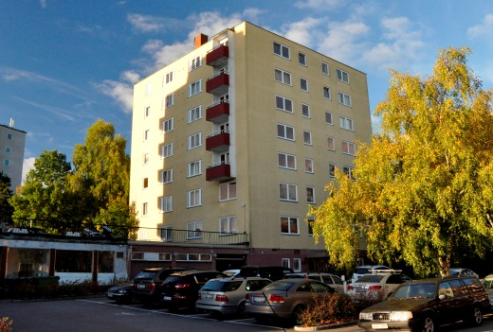
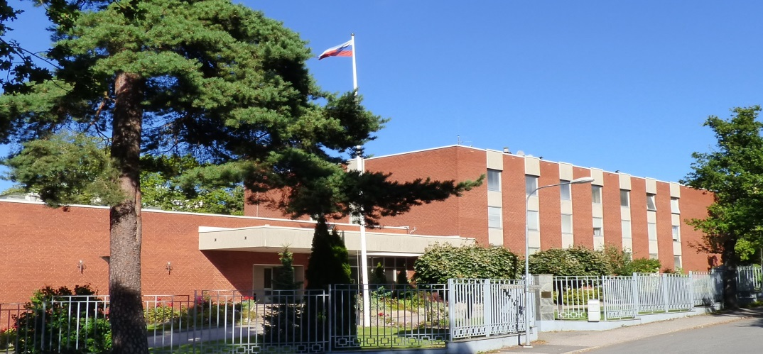
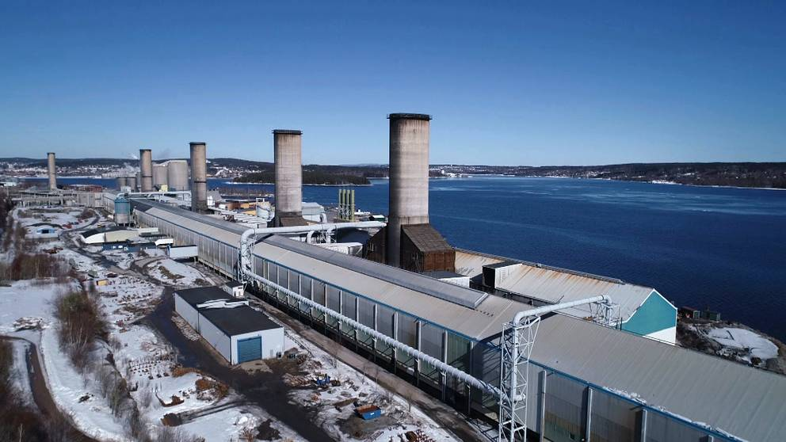
Trade Representation of the Russian Federation in the Kingdom of Sweden
The Trade Representation is an integral part of the diplomatic mission of the Russian Federation in Sweden but is subordinated directly to the Ministry of Industry and Trade of the Russian Federation.
It acts according to the Convention from October 8, 1927 between the USSR and Sweden about the legal statute of the Trade Representation in Sweden.
The Trade Representation provides assistance in the trade and economic collaboration between the Russian and the Swedish official bodies, individuals and legal entities.
Trade Representation of the Russian Federation in the Kingdom of Sweden
Ministry of Industry and Trade of the Russian Federation

Slide 6
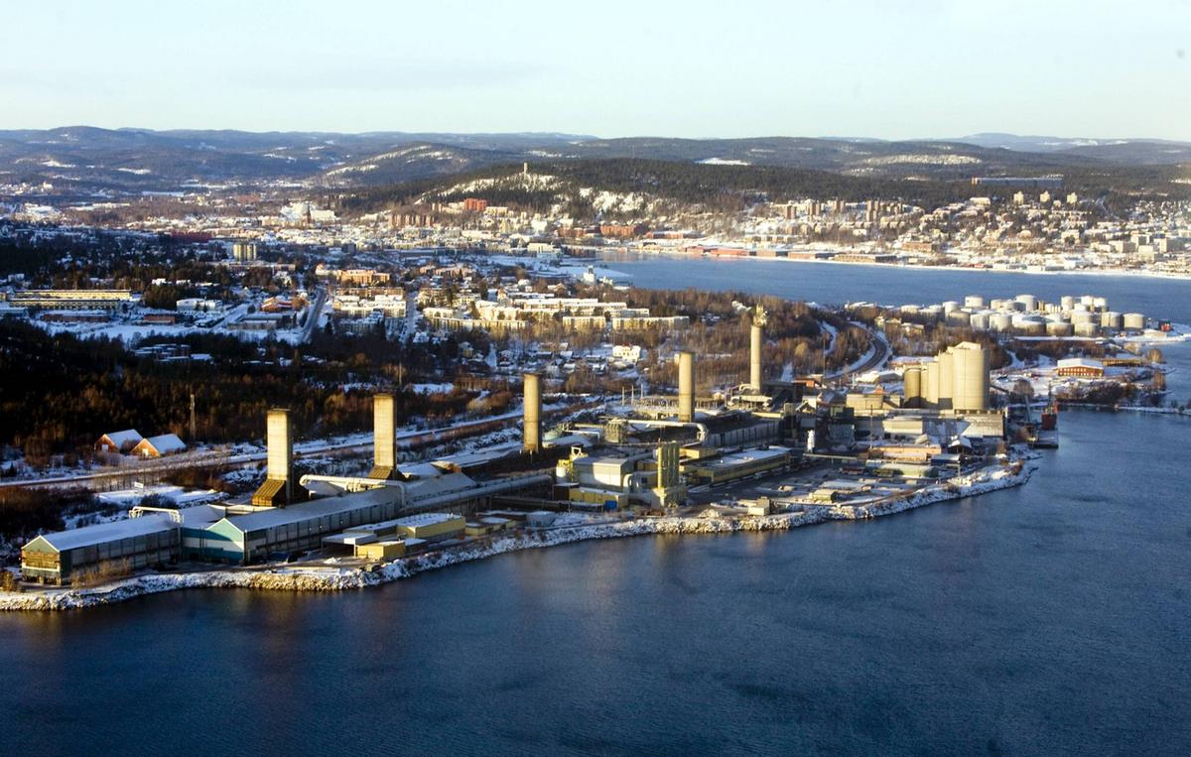

Kubikenborg Aluminium (Kubal)
Kubal is one of the largest industrial facilities in Sweden and the only primary aluminum producer in the country.
To meet the new European environmental legislation and improve performance the plant was successfully modernized 2008-2010. The overall investment of UC RUSAL into this project amounts to over $200 mln.
Now the production capacity of Kubal is 135,000 tonnes of saleable aluminum per annum, which satisfies half of all demand in Sweden. Approximately 50% of aluminum produced is supplied to customers in Sweden, and the remaining 50% goes to European customers.
Trade Representation of the Russian Federation in the Kingdom of Sweden
Ministry of Industry and Trade of the Russian Federation

Slide 7
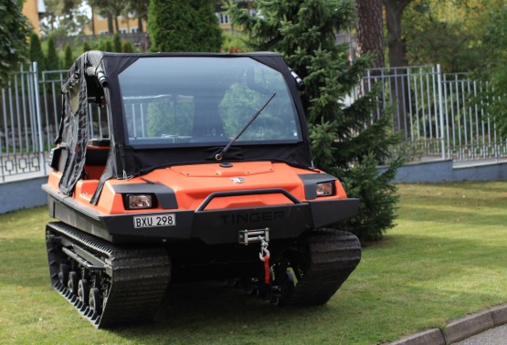



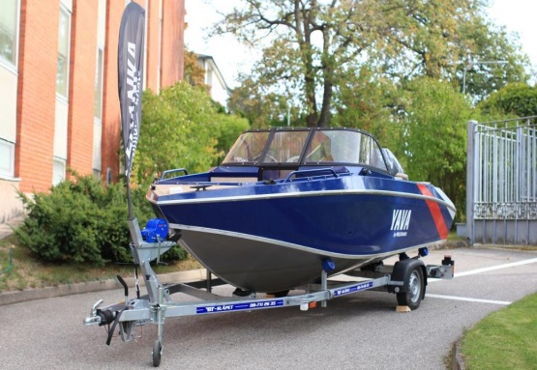



Priority Markets (part 1)
1. Automotive Industry
a) all-terrain vehicles
b) cars and LCVs
c) automotive components
2. Shipbuilding
a) small boats
b) hydrofoil ships
c) hovercrafts
3. Recycling Technologies
a) separate collection and utilization
b) waste landfills reclamation
4. Construction materials
a) dry mix
b) wooden frames and plywood
c) lightning equipment
d) facade panel
e) microfiber materials
f) materials for wooden house building
Trade Representation of the Russian Federation in the Kingdom of Sweden
Ministry of Industry and Trade of the Russian Federation

Slide 8
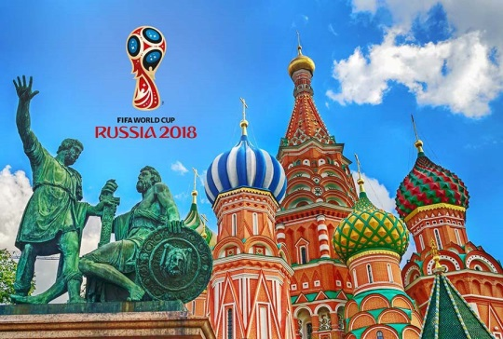



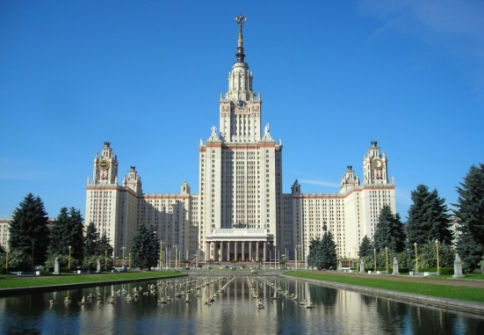


Priority Markets (part 2)
5. Attracting Swedish Tourists to Russia
a) medical tourism
b) ethnographic tourism
c) ecological tourism
d) extreme tourism
6. Study in Russia
a) high education in Russia
b) student exchange programs
7. Food Industry and Agriculture
a) natural honey
b) sunflower oil
c) fish and seafood
d) pasta
e) sweets and confectionery
f) alcoholic beverages
g) soft drinks
Trade Representation of the Russian Federation in the Kingdom of Sweden
Ministry of Industry and Trade of the Russian Federation

Slide 9



Trade Representation of the Russian Federation in the Kingdom of Sweden
Contact us:
From Sweden:
+46 8 765-97-70
+46 8 765-11-80
From Russia:
+7 495 870-29-27 (extension № 27190)
info@rysslandshandel.se
stockholm@minprom.gov.ru

